Slide 1
PHP Advanced PHP
Dr. Roshan D Suvaris
MCA Department

Slide 2
1 Origins and Uses of PHP
PHP was developed by Rasmus Lerdorf, a member of the Apache Group,2 in 1994.
Its initial purpose was to provide a tool to help Lerdorf track visitors to his personal Web site.
Originally, PHP was an acronym for Personal Home Page.
Later, its user community began using the recursive name PHP: Hypertext Preprocessor
As a server-side scripting language, PHP is naturally used for form handling and database access.
Because database access has been a prime focus of PHP development, it has driver support for 15 different database systems.
PHP supports the common electronic mail protocols POP3 and IMAP.
It also supports the distributed object architectures COM and CORBA.

Slide 3
2 Overview of PHP
PHP is a server-side HTML-embedded scripting language. As such, it is an alter native to Microsoft’s Active Server Pages and Sun’s Java Server Pages.
The way its scripts are interpreted, PHP is related to client-side JavaScript.
When a browser finds JavaScript code embedded in an HTML document it is displaying, it calls its JavaScript interpreter to interpret the script.
When a browser requests a document that includes PHP script, the Web server that provides the document calls its PHP processor.
The server determines that a document includes PHP script by the file-name extension. If it is .php, .php3, or .phtml, the document has embedded PHP.
The PHP processor has two modes of operation: copy mode and interpret mode.
The client never sees the PHP script. If the user clicks View Source while the browser is displaying the document, only the markup (and embedded client-side script) will be shown, because that is all that ever arrives at the client.

Slide 4
Continued…
The syntax and semantics of PHP are closely related to the syntax and semantics of JavaScript.
PHP uses dynamic typing, as does JavaScript. Variables are not type declared, and they have no intrinsic type.
the dynamic nature of PHP’s strings and arrays also contributes.
There is a large collection of functions for creating and manipulating PHP’s arrays.
PHP has an extensive library of functions, making it a flexible and powerful tool for server-side software development.
Many of the predefined functions are used to provide interfaces to other software systems, such as mail and database systems.

Slide 5
3 General Syntactic Characteristics
PHP scripts either are embedded in markup documents or are in files that are referenced by such documents.
PHP code is embedded in documents by enclosing it between the <?php and ?> tags.
If a PHP script is stored in a different file, it can be brought into a document with the include construct
include("table2.inc");
This construct causes the contents of the file table2.inc to be copied into the document in which the include appears.
The included file can contain markup or client-side script, as well as PHP code, but any PHP script it includes must be the content of a <?php tag, even if the include itself appears in the content of a <?php tag.
The PHP interpreter changes from interpret to copy mode when an include is encountered.

Slide 6
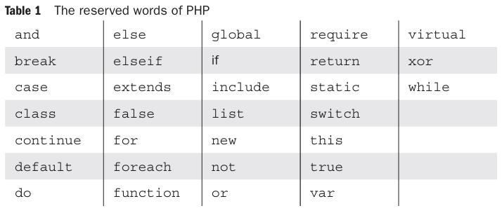
Continued…
Every variable name in PHP begins with a dollar sign ($).
The part of the name after the dollar sign is like the names of variables in many common programming languages: a letter or an underscore followed by any number (including zero) of letters, digits, or underscores.
PHP variable names are case sensitive.
Although variable names in PHP are case sensitive, neither reserved words nor function names are.
For example, there is no difference between while, WHILE, While, and wHiLe.

Slide 7
Continued…
PHP allows comments to be specified in three different ways.
Single-line comments can be specified either with # or with //, as in JavaScript.
Multiple line comments are delimited with /* and */, as in many other programming languages.
PHP statements are terminated with semicolons.
Braces are used to form compound statements for control structures.

Slide 8
4 Primitives, Operations, and Expressions
PHP has four scalar types—Boolean, integer, double, and string; two compound types—array and object; and two special types—resource and NULL.
4.1 Variables
Because PHP is dynamically typed, it has no type declarations.
In fact, there is no way or need to ever declare the type of a variable.
The type of a variable is set every time the variable is assigned a value.
An unassigned variable, sometimes called an unbound variable, has the value NULL
In expression the value of the unbound variable is changed based on the context
A variable can be tested to determine whether it currently has a value. The test is carried out with the IsSet function, which takes the variable’s name as its parameter and returns a Boolean value.
For example, IsSet($fruit)
If you want to be informed when an unbound variable is referenced, include a call to the error_reporting function with the parameter value 15.

Slide 9
4.2 Integer Type
PHP has a single integer type, named integer.
This type corresponds to the long type of C and its successors, which means its size is that of a word in the machine on which the program is run.
In most cases, this is 32 bits, or a bit less (not fewer) than 10 decimal digits.
4.3 Double Type
PHP’s double type corresponds to the double type of C and its successors.
Double literals can include a decimal point, an exponent, or both.

Slide 10
4.4 String Type
Characters in PHP are single bytes
String literals are defined with either single-quote (') or double-quote (") delimiters.
In single-quoted string literals, escape sequences, such as \n, are not recognized as anything special and the values of embedded variables are not substituted for their names.
'The sum is: $sum'
"The sum is: $sum“ will print: The sum is: 10.2
If a double-quoted string literal includes a variable name, but you do not want it interpolated, precede the first character of the name (the dollar sign) with a backslash (\).

Slide 11
4.5 Boolean Type
The only two possible values for the Boolean type are TRUE and FALSE, both of which are case insensitive.
If an integer expression is used in a Boolean context, it evaluates to FALSE if it is zero; otherwise, it is TRUE.
If a string expression is used in a Boolean context, it evaluates to FALSE if it is either the empty string or the string "0"; otherwise, it is TRUE.

Slide 12
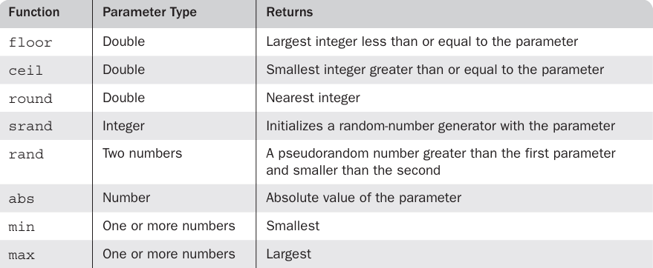
4.6 Arithmetic Operators and Expressions
PHP has the usual (for C-based programming languages) collection of arithmetic operators (+, -, *, /, %, ++, and --) with the usual meanings.
Integer division is done and the result is not an integral value, the result is returned as a double.
Any operation on integers that results in integer overflow also produces a double.
PHP has a large number of predefined functions that operate on numeric values.

Slide 13
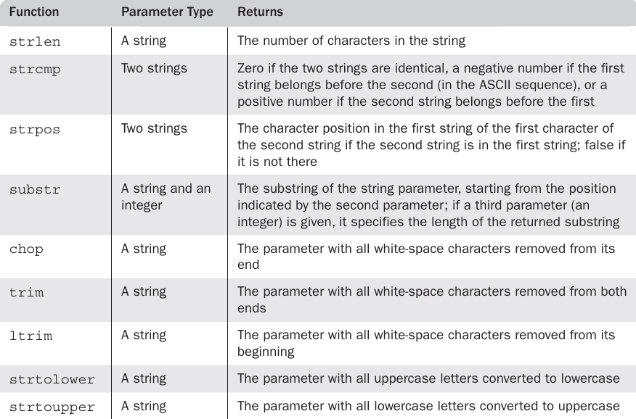
4.7 String Operations
The only string operator is the catenation operator, specified with a period (.).
String variables can be treated somewhat like arrays for access to individual characters.
For example, if $str has the value "apple", $str{3} is "l".

Slide 14
4.8 Scalar Type Conversions
PHP, like most other programming languages, includes both implicit and explicit type conversions.
Implicit type conversions are called coercions.
In most cases, the context of an expression determines the type that is expected or required.
Whenever a numeric value appears in a string context, the numeric value is coerced to a string.
Like wise, whenever a string value appears in a numeric context, the string value is coerced to a numeric value.
Explicit type conversions can be specified in three different ways.
Typecast - (int)$sum
Another way to specify explicit type conversion is to use one of the functions intval, doubleval, or strval. - intval($sum)
The third way to specify an explicit type conversion is with the settype function
settype($sum, "integer");

Slide 15
Continued…
The type of the value of a variable can be determined in two different ways.
The first is the gettype function, which takes a variable as its parameter and returns a string that has the name of the type of the current value of the variable.
One possible return value of gettype is "unknown".
The other way to determine the type of the value of a variable is to use one or more of the type-testing functions, each of which takes a variable name as a parameter and returns a Boolean value.
These functions are is_int, is_integer, and is_long, which test for integer type; is_double, is_float, and is_real, which test for double type; is_bool, which tests for Boolean type; and is_string, which tests for string type

Slide 16
4.9 Assignment Operators
PHP has the same set of assignment operators as its predecessor language, C, including the compound assignment operators such as += and /=.

Slide 17
5 Output
Any output from a PHP script becomes part of the document the PHP processor is building.
Therefore, all output must be in the form of HTML or XHTML, which may include embedded client-side script.
The print function is used to create simple unformatted output
It can be called with or without parentheses around its parameter.
Print "Apples are red Kumquats aren't ";
Although print expects a string parameter, if some other type value is given, the PHP interpreter will coerce it to a string without complaint.
Because variables that appear in double-quoted strings are interpolated, it is easy to label output.
print "The result is: $result ";

Slide 18
Continued…
PHP borrows the printf function from C. It is used when control over the format of displayed data is required.
printf(literal_string, param1, param2, ...)
The literal string can include labeling information about the parameters whose values are to be displayed.
It also contains format codes for those values.
The form of the format codes is a percent sign (%) followed by a field width and a type specifier.
The most common type specifiers are s for strings, d for integers, and f for floats and doubles.
%10s—a character string field of 10 characters
%6d—an integer field of six digits
%5.2f—a float or double field of eight spaces
$day = "Tuesday";
$high = 79;
printf("The high on %7s was %3d", $day, $high);

Slide 19
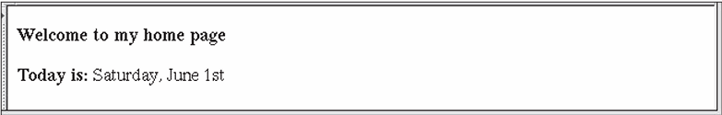
Example
<!DOCTYPE html>
<!-- today.php - A trivial example to illustrate a php document -->
<html lang = "en">
<head>
<title> today.php </title>
<meta charset = "utf-8" />
</head>
<body>
<p>
<?php
print "<b>Welcome to my home page <br /> <br />";
print "Today is:</b> ";
print date("l, F jS");
print "<br />";
?>
</p>
</body>
</html>

Slide 20
6 Control Statements
The control expression used in PHP’s control statements can be of any type.
The interpreter evaluates the control expression and, in the cases of if and loop statements, coerces the resulting value, if necessary, to Boolean.
6.1 Relational Operators
PHP uses the eight relational operators of JavaScript.
The usual six (>, =, <=, !=, and ==) have the usual meanings.
PHP also has ===, which produces TRUE only if both operands are the same type and have the same value, and !==, the opposite of ===.
If the types of the operands of the other six relational operators are not the same, one is coerced to the type of the other.

Slide 21
6.2 Boolean Operators
There are six Boolean operators: and, or, xor, !, &&, and ||.
The and and && operators perform the same operation, as do or and ||.
The difference between them is that the precedence of and and or is lower than that of && and ||.
6.3 Selection Statements
PHP’s if statement is like that of C.
The control expression can be an expression of any type, but its value is coerced to Boolean.
The controlled statement segment can be either a single statement or a compound statement.
if ($num > 0)
$pos_count++;
elseif ($num < 0)
$neg_count++;
else {
$zero_count++;
Print "Another zero! <b />";
}

Slide 22
Continued…
The switch statement has the form and semantics of that of JavaScript.
The type of the control expression and of the case expressions is either integer, double, or string.
If necessary, the values of the case expressions are coerced to the type of the control expression for the comparisons.
A default case can be included.
switch ($bordersize) {
case "0": print "<table>";
break;
case "1": print "<table border = '1'>";
break;
case "4": print "<table border = '4'>";
break;
case "8": print "<table border = '8'>";
break;
default: print "Error-invalid value: $bordersize <br />";
}

Slide 23
6.4 Loop Statements
The while, for, and do-while statements of PHP are exactly like those of JavaScript.
PHP also has a foreach statement
while loop
$fact = 1;
$count = 1;
while ($count < $n) {
$count++;
$fact *= $count;
}
do while loop
$count = 1;
$sum = 0;
do {
$sum += $count;
$count++;
} while ($count <= 100);

Slide 24
continued…
for loop
for ($count = 1, $fact = 1; $count < $n;) {
$count++;
$fact *= $count;
}
The break statement can be used to terminate the execution of a for, foreach, while, or do-while construct.
The continue statement is used in loop constructs to skip the remainder of the current iteration but continue execu tion at the beginning of the next.

Slide 25
<!DOCTYPE html>
<!-- powers.php
An example to illustrate loops and arithmetic -->
<html lang = "en">
<head>
<title> powers.php </title>
<meta charset = "utf-8" />
<style type = "text/css">
td, th, table {border: thin solid black;}
</style>
</head>
<body>
<table>
<caption> Powers table </caption>
<tr>
<th> Number </th>
<th> Square Root </th>
<th> Square </th>
<th> Cube </th>
<th> Quad </th>
</tr>
<?php
for ($number = 1; $number <=10; $number++) {
$root = sqrt($number);
$square = pow($number, 2);
$cube = pow($number, 3);
$quad = pow($number, 4);
print("<tr align = 'center'> <td> $number </td>");
print("<td> $root </td> <td> $square </td>");
print("<td> $cube </td> <td> $quad </td> </tr>");
}
?>
</table>
</body>
</html>

Slide 26
7 Arrays
Arrays in PHP are unlike those of any other common programming language.
They are best described as a combination of the arrays of a typical language and associative arrays, or hashes, found in some other languages, such as Ruby and Python.
Each array element consists of two parts: a key and a value.
If the array has a logical structure that is similar to an array in another language, the keys just happen to be nonnegative integers
If the array has a logical structure that is similar to a hash, its keys are strings
The string keys of a PHP array are sometimes people’s names, sometimes the names of the days of the week.

Slide 27
7.1 Array Creation
There are two ways to create an array in PHP
Assigning a value to a sub scripted variable that previously was not an array creates the array.
$list[0] = 17;
If empty brackets are used in an assignment to an array, a numeric key is implicitly furnished.
The furnished subscript is 1 greater than the largest numeric key used so far in the array
If the array currently has no elements with numeric keys, the value 0 is used.
$list[1] = "Today is my birthday!";
$list[] = 42;

Slide 28
continued…
The second way to create an array is with the array construct.
The parameters of array specify the values to be placed in a new array and sometimes also the keys.
If the array is like a traditional array, only the values need to be specified; the PHP interpreter will furnish the numeric keys.
$list = array(17, 24, 45, 91);
If you would rather have different keys, you can specify them in the array construct, as follows:
$list = array(1 => 17, 2 => 24, 3 => 42, 4 => 91);
An array construct with empty parentheses creates an empty array.
$list = array();
The following statement creates an array that has the form of a hash:
$ages = array("Joe" => 42, "Mary" => 41, "Bif" => 17);
PHP arrays do not need to be purely in the form of traditional arrays or hashes
$stuff = array("make" => "Cessna", "model" => "C210", "year" => 1960, 3 => "sold");

Slide 29
7.2 Accessing Array Elements
Individual array elements can be accessed by subscripting, as in other programming languages.
The value in the subscript, which is enclosed in brackets, is the key of the value being referenced.
$ages['Mary'] = 29;
The list construct can be used to assign multiple elements of an array to scalar variables in one statement.
$trees = array("oak", "pine", "binary");
list($hardwood, $softwood, $data_structure) = $trees;

Slide 30
7.3 Functions for Dealing with Arrays
A whole array can be deleted with unset, as with a scalar variable. Individual elements of an array also can be removed with unset.
$list = array(2, 4, 6, 8);
unset($list[2]);
The collection of keys and the collection of values of an array can be extracted with built-in functions.
$highs = array("Mon" => 74, "Tue" => 70, "Wed" => 67, "Thu" => 62, "Fri" => 65);
$days = array_keys($highs);
$temps = array_values($highs);
The existence of an element of a specific key can be determined with the array_key_exists function, which returns a Boolean value.
$highs = array("Mon" => 74, "Tue" => 70, "Wed" => 67, "Thu" => 62, "Fri" => 65);
if (array_key_exists("Tue", $highs)) {
$tues_high = $highs["Tue"];
print "The high on Tuesday was $tues_high <br />";
} else
print "There is data for Tuesday in the \$highs array <br />";

Slide 31
continue…
The is_array function is similar to the is_int function: It takes a variable as its parameter and returns TRUE if the variable is an array, FALSE otherwise.
The in_array function takes two parameters—an expression and an array—and returns TRUE if the value of the expression is a value in the array; otherwise, it returns FALSE.
The number of elements in an array can be determined with the sizeof function.
$list = array("Bob", "Fred", "Alan", "Bozo");
$len = sizeof($list);

Slide 32
continue…
It is often useful to be able to convert between strings and arrays.
These conversions can be done with the implode and explode functions.
The explode function explodes a string into substrings and returns them in an array.
The delimiters of the substrings are defined by the first parameter of explode, which is a string; the second parameter is the string to be converted.
$str = "April in Paris, Texas is nice";
$words = explode(" ", $str);
The implode function does the inverse of explode.
$words = array("Are", "you", "lonesome", "tonight");
$str = implode(" ", $words);

Slide 33
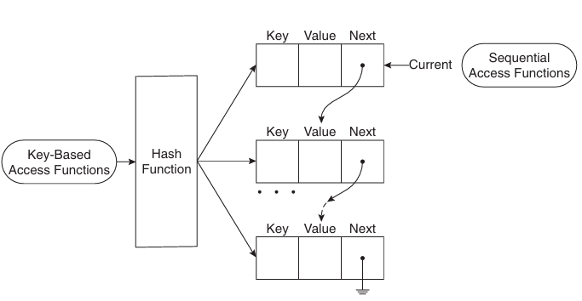
Continue…
Internally, the elements of an array are stored in a linked list of cells, where each cell includes both the key and the value of the element.
The cells themselves are stored in memory through a key-hashing function so that they are randomly distributed in a reserved block of storage.
Accesses to elements through string keys are implemented through the hashing function.
However, the elements all have links that connect them in the order in which they were created, allowing them to be accessed in that order if the keys are strings and in the order of their keys if the keys are numbers.

Slide 34
7.4 Sequential Access to Array Elements
PHP includes several different ways to access array elements in sequential order.
Every array has an internal pointer that references one element of the array.
We call this the “current” pointer. This pointer is initialized to reference the first element of the array at the time the array is created.
The element being referenced by the pointer can be obtained with the current function.
$cities = array("Hoboken", "Chicago", "Moab", "Atlantis");
$city = current($cities);
print("The first city is $city <br />");
The “current” pointer can be moved with the next function
$city = current($cities);
print("$city <br />");
while ($city = next($cities))
print("$city <br />");

Slide 35
continue…
The each function, which returns a two-element array consisting of the key and the value of the “current” element
It returns FALSE only if the “current” pointer has gone past the last element of the array.
The keys of the two elements of the return value from each are the strings "key" and "value".
$salaries = array("Mike" => 42500, "Jerry" => 51250, "Fred" => 37920);
while ($employee = each($salaries)) {
$name = $employee["key"];
$salary = $employee["value"];
print("The salary of $name is $salary <br />");
}
The “current” pointer can be moved backward (i.e., to the element before the “current” element) with the prev function.
The “current” pointer can be set to the first element with the reset function
It can be set to the last element of the array with the end function

Slide 36
continue...
The key function, when given the name of an array, returns the key of the “current” element of the array
The array_push and array_pop functions provide a simple way to implement a stack in an array.
The foreach statement is designed to build loops that process all of the elements of an array.
foreach (array as scalar_variable) loop body
foreach (array as key => value) loop body
Example
foreach ($list as $temp)
print("$temp <br />");
When interpreted, these statements produce the values of all of the elements of $list.

Slide 37
continue…
The second form of foreach provides both the key and the value of each element of the array
$lows = array("Mon" => 23, "Tue" => 18, "Wed" => 27);
foreach ($lows as $day => $temp)
print("The low temperature on $day was $temp <br />");

Slide 38
7.5 Sorting Arrays
The sort function, which takes an array as a parameter, sorts the values in the array, replacing the keys with the numeric keys, 0, 1, 2, ....
The array can have both string and numeric values.
Regardless of the types of the keys in the original array, the sorted array has 0, 1, 2, and so forth as keys.
The asort function is used to sort arrays that correspond to hashes. It sorts the elements of a given array by their values, but keeps the original key–value associations.
The ksort function sorts its given array by keys, rather than values. The key–value associations are maintained by the process.
The rsort, arsort, and krsort functions behave like the sort, asort, and ksort functions, respectively, except that they sort into the reverse orders of their counterparts.

Slide 39
<!DOCTYPE html>
<!-- sorting.php - An example to illustrate several of the
sorting functions -->
<html lang = "en">
<head>
<title> Sorting </title>
<meta charset = "utf-8" />
</head>
<body>
<?php
$original = array("Fred" => 31, "Al" => 27, "Gandalf" => "wizard", "Betty" => 42, "Frodo" => "hobbit");
?>
<h4> Original Array </h4>
<?php
foreach ($original as $key => $value)
print("[$key] => $value <br />");
$new = $original;
sort($new);
?>
<h4> Array sorted with sort </h4>
<?php
foreach ($new as $key => $value)
print("[$key] = $value <br />");
$new = $original;
asort($new);
?>

Slide 40
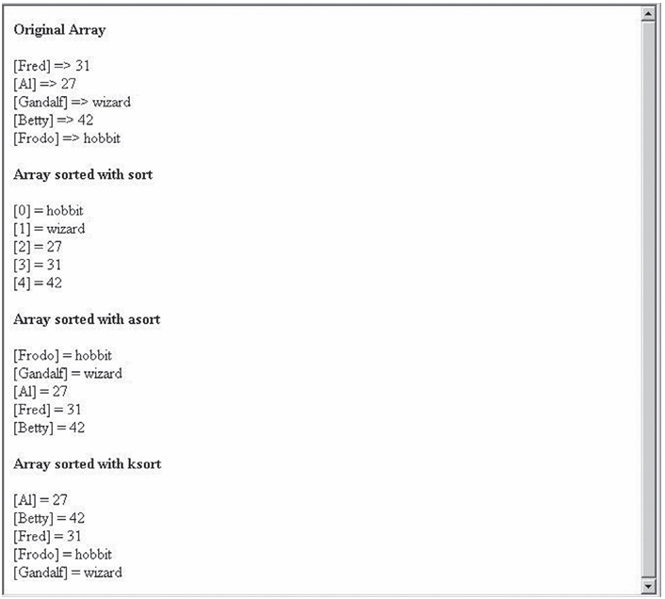
<h4> Array sorted with asort </h4>
<?php
foreach ($new as $key => $value)
print("[$key] = $value <br />");
$new = $original;
ksort($new);
?>
<h4> Array sorted with ksort </h4>
<?php
foreach ($new as $key => $value)
print("[$key] = $value <br />");
?>
</body>
</html>

Slide 41
8 Functions
PHP supports user-defined functions that are typical of C-based programming languages.
8.1 General Characteristics of Functions
The general form of a PHP function definition is as follows:
function name([parameters]) {
...
}
The square brackets around the parameters mean that the parameters are optional.
If a second definition of a function appears in a script, it is reported as an error because function overloading is not allowed
function names are not case sensitive.
The return statement is used in a function to specify the value to be returned to the caller.
If no return statement was executed, no value is returned.

Slide 42
8.2 Parameters
As with JavaScript, we call the parameters in the call to a function actual parameters.
We call the parameters that are listed in the function definition formal parameters.
An actual parameter can be any expression. A formal parameter must be a variable name.
The number of actual parameters in a call to a function need not match the number of formal parameters defined in that function.
The default parameter-passing mechanism of PHP is pass by value.
function max_abs($first, $second) {
$first = abs($first);
$second = abs($second);
if ($first >= $second)
return $first;
else
return $second;
}

Slide 43
continue…
Pass-by-reference parameters can be specified in PHP in two ways.
One way is to add an ampersand (&) to the beginning of the name of the formal parameter that you want to be passed by reference.
The other way to specify pass-by-reference is to add an ampersand to the actual parameter in the function call.
function set_max(&$max, $first, $second) {
If ($first >= $second)
$max = $first;
else
$max = $second;
}

Slide 44
8.3 The Scope of Variables
The default scope of a variable defined in a function is local.
function summer($list) {
$sum = 0;
foreach ($list as $value)
$sum += $value;
return $sum;
}
$sum = 10;
$nums = array(2, 4, 6, 8);
$ans = summer($nums);
print "The sum of the values in \$nums is: $ans <br />";
print "The value of \$sum is still: $sum <br />";
The sum of the values in $nums is: 20
The value of $sum is still: 10

Slide 45
continued…
In some cases, it is convenient for the code in a function to be able to access a variable that is defined outside the function.
For this situation, PHP has the global declaration.
$big_sum = 0;
...
/* Function summer
Parameter: An array of integers
Returns: The sum of the elements of the parameter
array
Side effect: Add the computed sum to the global,
$big_sum
*/
function summer ($list) {
global $big_sum; //** Get access to $big_sum
$sum = 0;
foreach ($list as $value)
$sum += $value;
$big_sum += $sum;
return $sum;
} //** end of summer
...
$ans1 = summer($list1);
$ans2 = summer($list2);
...
print "The sum of all array elements is: $big_sum <br />";

Slide 46
8.4 The Lifetime of Variables
In some situations, a function must be history sensitive; that is, it must retain information about previous activations.
The default lifetime of local variables in a PHP function is from the time the variable is first used (i.e., when storage for it is allocated) until the function’s execution terminates.
To support history sensitivity, a function must have static local variables. The lifetime of a static variable in a function begins when the variable is first used in the first execution of the function.
Its lifetime ends when the script execution ends.
In the case of PHP, this is when the browser leaves the document in which the PHP script is embedded.
In PHP, a local variable in a function can be specified to be static by declaring it with the reserved word static.
Such a declaration can include an initial value, which is only assigned the first time the declaration is reached.

Slide 47
continue…
function do_it ($param) {
static $count = 0;
count++;
print "do_it has now been called $count times <br />";
...
}
When called, this function displays the number of times it has been called, even if it is called from several different places.
The fact that its local variable $count is static allows this to be done.

Slide 48
9 Pattern Matching
PHP includes two different kinds of string pattern matching using regular expressions:
one that is based on POSIX regular expressions and
one that is based on Perl regular expressions, like those of JavaScript.
The POSIX regular expressions are compiled into PHP, but the Perl-Compatible Regular Expression (PCRE) library must be compiled before Perl regular expressions can be used.

Slide 49
continue...
PHP function for pattern matching
The preg_match function takes two parameters, the first of which is the Perl-style regular expression as a string. The second parameter is the string to be searched.
if (preg_match("/^PHP/", $str))
print "\$str begins with PHP <br />";
else
print "\$str does not begin with PHP <br />";
The preg_split function operates on strings but returns an array and uses patterns
The function takes two parameters, the first of which is a Perl-style pattern as a string. The second parameter is the string to be split.
$fruit_string = "apple : orange : banana";
$fruits = preg_split("/ : /", $fruit_string);

Slide 50
10 Form Handling
One common way for a browser user to interact with a Web server is through forms.
A form is presented to the user, who is invited to fill in the text boxes and click the buttons of the form.
The user submits the form to the server by clicking the form’s Submit button.
The contents of the form are encoded and transmitted to the server, which must use a program to decode the contents, perform what ever computation is necessary on the data, and produce output in the form of a markup document that is returned to the client.
When PHP is used to process form data, it implicitly decodes the data.
It may seem strange, but when PHP is used for form handling, the PHP script is embedded in an HTML document, as it is with other uses of PHP.

Slide 51
continue…
Although it is possible to have a PHP script handle form data in the same HTML document that defines the form, it is perhaps clearer to use two separate documents.
For this latter case, the document that defines the form specifies the document that handles the form data in the action attribute of its <form> tag.
PHP can be configured so that form data values are directly available as implicit variables whose names match the names of the corresponding form elements.
The recommended approach is to use the implicit arrays $_POST and $_GET for form values.
These arrays have keys that match the form element names and values that were input by the client.
For example, if a form has a text box named phone and the form method is POST, the value of that element is available in the PHP script as follows:
$_POST["phone"]
Example – popcorn.php

Slide 52
11 Cookies
11.1 Introduction to Cookies
A session is the time span during which a browser interacts with a particular server.
A session begins when a browser connects to the server.
That session ends either when the browser is terminated or because the server terminated the session because of client inactivity.
The length of time a server uses as the maximum time of inactivity is set in the configuration of the server.
For example, the default maximum for some servers is 30 minutes.
The HTTP protocol is essentially stateless: It includes no means to store information about a session that is available to a subsequent session.
However, there are a number of different reasons that it is useful for the server to be capable of connecting a request made during a session to the other requests made by the same client during that session, as well as to requests made during previous and subsequent sessions - shopping carts on Web sites.

Slide 53
continued…
An e-commerce site can have any number of simultaneous online customers.
At any time, any customer can add an item to or remove an item from his or her cart.
Each user’s shopping cart is identified by a session identifier, which could be implemented as a cookie.
So, cookies can be used to identify each of the customers visiting the site at a given time.
Besides identifying customers, another common use of cookies is for a Web site to create profiles of visitors by remembering which parts of the site are perused by that visitor. Sometimes this is called personalization.
Later sessions can use such profiles to target advertising to the client in line with the client’s past interests.
Storing session information is becoming increasingly important as more and more Web sites make use of shopping carts, targeted advertising, and personalization.

Slide 54
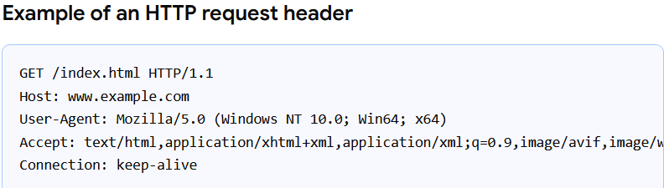
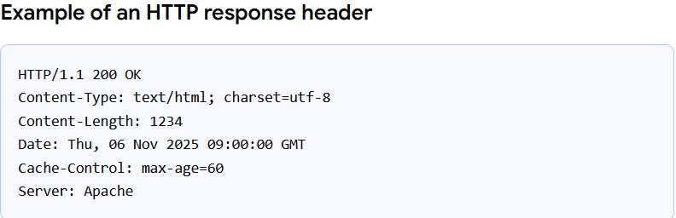
continued…
Cookies provide a general approach to storing information about sessions on the browser system itself.
A cookie is a small object of information that includes a name and a textual value.
A cookie is created by some software system on the server.
Every HTTP communication between a browser and a server includes a header, which stores information about the message.
The header part of an HTTP communication can include cookies.
So, every request sent from a browser to a server, and every response from a server to a browser, can include one or more cookies.

Slide 55
continued…
At the time it is created, a cookie is assigned a lifetime after it is deleted from the browsers host machine.
Every browser request includes all of the cookies its host machine has stored that are associated with the Web server to which the request is directed – the cookies are handled by the server which has created it.
Because cookies allow servers to record browser activities, some consider them to involve privacy concerns.

Slide 56
11.2 PHP Support for Cookies
A cookie is set in PHP with the setcookie function.
This function takes one or more parameters.
The first parameter, which is mandatory, is the cookie’s name given as a string.
The second, if present, is the new value for the cookie, also a string. If the value is absent, setcookie undefines the cookie.
The third parameter, when present, is the expiration time in seconds for the cookie, given as an integer.
The default value for the expiration time is zero, which specifies that the cookie is destroyed at the end of the current session.
setcookie("voted", "true", time() + 86400);

Slide 57
continued…
The other cookie operation is getting the cookies and their values from sub sequent browser requests.
In PHP, cookie values are treated much as are form values. All cookies that arrive with a request are placed in the implicit $_COOKIES array, which has the cookie names as keys and the cookie values as values.
A PHP script can test whether a cookie came with a request by using the IsSet predicate function on the associated variable.

Slide 58
12 Session Tracking
In some cases, information about a session is needed only during the session.
Also, the needed information about a client is nothing more than a unique identifier for the session—commonly used in shopping cart applications.
For these cases, a different process, named session tracking, can be used.
Rather than using one or more cookies, a single session array can be used to store information about the previous requests of a client during a session.
In particular, session arrays often store a unique session ID for a session.
One significant way that session arrays differ from cookies is that they can be stored on the server, whereas cookies are stored on the client.

Slide 59
continued…
In PHP, a session ID is an internal value that identifies the session.
PHP is made aware that a script is interested in session tracking by calling the session_ start function, which takes no parameters.
The first call to session_start in a session causes a session ID to be created and recorded.
On subsequent calls to session_start in the same session, the function retrieves the $_SESSION array, which stores any session variables and their values that were registered in previously executed scripts in that session.
Session key-value pairs are created or changed by assignments to the $_SESSION array. They can be destroyed with the unset operator
session_start();
if (!IsSet($_SESSION["page_number"]))
$_SESSION["page_number"] = 1;
$page_num = $_SESSION["page_number"];
print("You have now visited $page_num page(s) <br />");
$_SESSION["page_number"]++;

Slide 60
continued…
If this is not the first document visited that calls session_start and sets the page_number session variable, the script that it executes will produce the specified line with the last set value of $_SESSION["page_number"].
If no document that was previously visited in this session set page_number, the script sets page_number to 1

Slide 61
Database Access with PHP and MySQL
1. Create the Database Table (MySQL)
Run this SQL in phpMyAdmin:
CREATE DATABASE studentdb;
USE studentdb;
CREATE TABLE students (
regno INT PRIMARY KEY,
name VARCHAR(50),
age INT,
address VARCHAR(100)
);

Slide 62
continued…
<?php
$host = "localhost";
$user = "root";
$pass = "";
$db = "studentdb";
// Create connection
$conn = mysqli_connect($host, $user, $pass, $db);
if (!$conn) {
die("Connection failed: " . mysqli_connect_error());
}
// Handle Insert
if (isset($_POST['insert'])) {
$reg = $_POST['regno'];
$name = $_POST['name'];
$age = $_POST['age'];
$addr = $_POST['address'];
$sql = "INSERT INTO students VALUES ('$reg', '$name', '$age', '$addr')";
mysqli_query($conn, $sql);
}

Slide 63
Continued…
// Handle Delete
if (isset($_POST['delete'])) {
$reg = $_POST['regno'];
$sql = "DELETE FROM students WHERE regno='$reg'";
mysqli_query($conn, $sql);
}
// Handle Update
if (isset($_POST['update'])) {
$reg = $_POST['regno'];
$name = $_POST['name'];
$age = $_POST['age'];
$addr = $_POST['address'];
$sql = "UPDATE students SET name='$name', age='$age', address='$addr' WHERE regno='$reg'";
mysqli_query($conn, $sql);
}
?>

Slide 64
<!DOCTYPE html>
<html>
<head>
<title>CRUD Operations</title>
<style>
body {
font-family: Arial;
padding: 20px;
}
input[type="text"], input[type="number"] {
padding: 8px;
margin: 6px;
width: 250px;
}
input[type="submit"] {
padding: 8px 20px;
margin: 6px;
font-size: 15px;
}
table {
margin-top: 20px;
border-collapse: collapse;
width: 80%;
}
table, th, td {
border: 1px solid black;
padding: 10px;
}
</style>
</head>

Slide 65
<body>
<h2>PHP MySQL CRUD Operations</h2>
<form method="post">
<input type="text" name="regno" placeholder="Register Number" required><br>
<input type="text" name="name" placeholder="Name"><br>
<input type="number" name="age" placeholder="Age"><br>
<input type="text" name="address" placeholder="Address"><br>
<input type="submit" name="insert" value="Insert">
<input type="submit" name="delete" value="Delete">
<input type="submit" name="update" value="Update">
<input type="submit" name="display" value="Display">
</form>

Slide 66
<?php
// Handle Display
if (isset($_POST['display'])) {
$result = mysqli_query($conn, "SELECT * FROM students");
if (mysqli_num_rows($result) > 0) {
echo "<table>
<tr>
<th>Register Number</th>
<th>Name</th>
<th>Age</th>
<th>Address</th>
</tr>";
while ($row = mysqli_fetch_assoc($result)) {
echo "<tr>
<td>".$row['regno']."</td>
<td>".$row['name']."</td>
<td>".$row['age']."</td>
<td>".$row['address']."</td>
</tr>";
}
echo "</table>";
} else {
echo "<p>No records found.</p>";
}
}
?>
</body>
</html>

Slide 67
END

